Slide 1

MDCC
Health Science Programs
Dream Big . Plan Well.
Be Anything.

Slide 2

Health Sciences
The Health Science Division is comprised of the following Allied Health Programs: Dental Hygiene Technology, Medical Laboratory Technology, Radiologic Technology, Physical Therapist Assistant, Phlebotomy and the following Nursing Programs: Associate Degree Nursing, Practical Nursing, and Health Care Assistant.
Students applying for admission into Health Science programs must meet the general college admission requirements. In addition, each program has individual requirements. Students wishing to apply to a specific program should consult the Policy of Admission to Health Science Programs and admission requirements specific to the individual program.

Slide 3
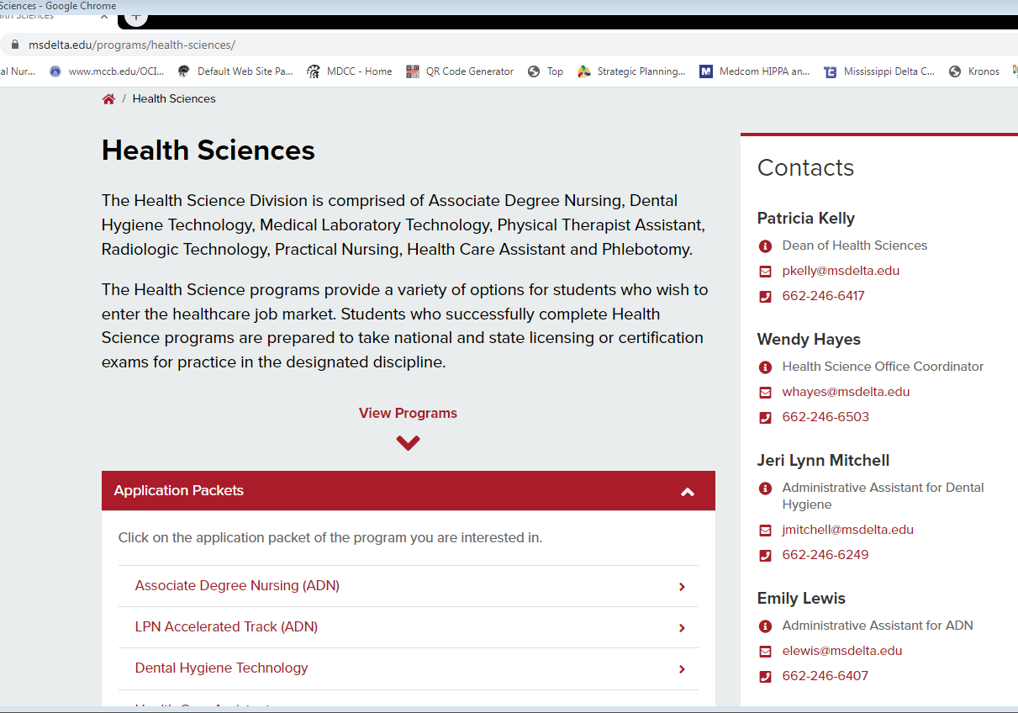
Applying to a Health Science Program
First the Student must Apply for General Admission
Second Must Apply to each Health Science Program (the link to the application is found under “Health Sciences”
Pay Attention to Deadlines and ACT Requirements

Slide 4
Program Check Sheet
Programs utilize program specific check sheets during selection to identify approved courses. The check sheets can be found on each programs webpage and in the application packet
Example ACT Requirements is from Dental Hygiene
18 ACT score (15 if taken before October 28, 1989) for first time freshman with not college credit hours
16 ACT score (12 if taken before October 28, 1989) with 12 hours college credit (course approved) with a “C” average or better on courses that are approved by DHT program

Slide 5

TEAS Entrance Test
Required for many of our Health Science Programs
Must be taken within 18 months of application deadline
Can only be taken 2 times 45 days apart during the application year if you submit testing taken at any other time the score will not be accepted
The TEAS can be taken remotely at home (computerized proctoring) or by paper on the MDCC campus information on registration can be found on the MDCC Health Sciences home page or in your application packet

Slide 6
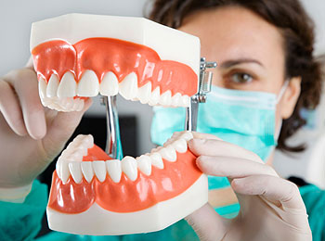
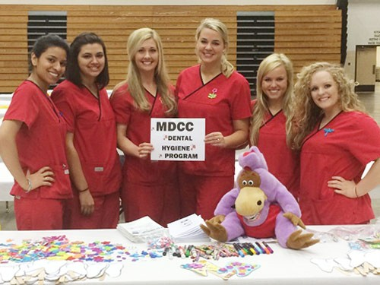
Dental Hygiene Technology
2 Year AAS Degree Program
Admission Requirements
18 ACT score (15 if taken before October 28, 1989) for first time freshman with not college credit hours
16 ACT score (12 if taken before October 28, 1989) with 12 hours college credit (course approved) with a “C” average or better on courses that are approved by DHT program.
Must be 18 years of age at the start of the program
Completion of A&P 1 and 2, Chemistry I (General or Principles), Microbiology (lecture and lab) with “C” or better within the last 5 years prior to admission
Entrance Test within 18 months of application deadline. Can only be taken 2 times 45 days apart during the application year.
Observation hours at MDCC Dental clinic Application Period-November- March 1st
A registered dental hygienist (RDH) is a licensed member of the oral health team who provides treatment to prevent oral diseases such as dental caries (cavities) and periodontal disease (gum diseases). The dental hygienist also instructs patients on methods to improve and maintain optimal oral health. . Graduates of the program are eligible to write for state and national certification exam. Each state has its own specific regulations and licensure requirements. The range of services performed by a dental hygienist will vary from state to state.

Slide 7
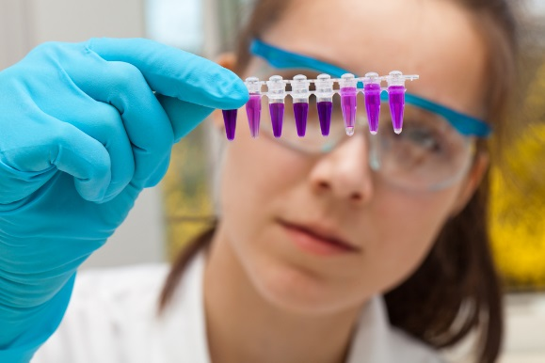
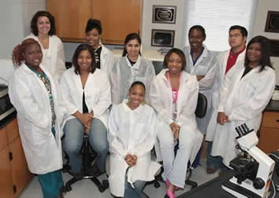
Medical laboratory Technology (MLT)
2 Year AAS Degree Program
Admission Requirements
18 ACT score (15 if taken before October 28, 1989) for first time freshman with not college credit hours
16 ACT score (12 if taken before October 28, 1989) with 12 hours college credit (course approved) with a “C” average or higher
Must be 18 years of age at the start of the program
Entrance Test within 18 months of application deadline. Can only be taken 2 times 45 days apart during the application year if you submit testing taken at any other time the score will not be accepted
Application Period-November - April 1st
Medical Laboratory Technicians (MLT) work together with Medical Technologist (MT) and Pathologist (MD) in the laboratory to solve the mysteries, put the puzzles together, and answer the critical questions of medicine. Seventy to eighty percent of medical decisions made by physicians are based on laboratory findings. Graduates of the program are awarded an Associate of Applied Science degree and are eligible to write for a national certification exam.

Slide 8

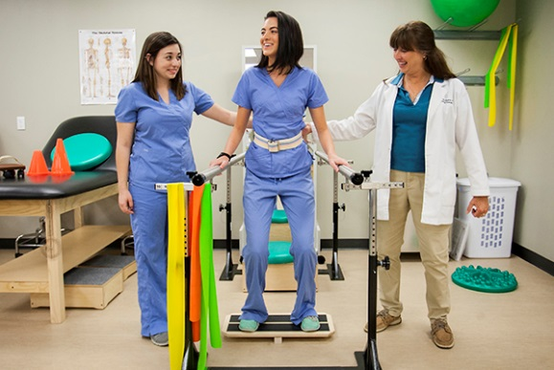
Physical Therapy Assistant
Admission Requirements
18 ACT score (15 if taken before October 28, 1989) for first time freshman with not college credit hours
16 ACT score (12 if taken before October 28, 1989) with 12 hours college credit (course approved) with a “C” average or better on courses that are approved by the PTA program
Completion of A&P 1 and 2 (lecture and lab) with “C” or better within the last 5 years prior to admission
Entrance Test within 18 months of application deadline. Can only be taken 2 times 45 days apart during the application year if you submit testing taken at any other time the score will not be accepted
Must be 18 years of age at the start of the program
Observation hours with a licensed PTA
Application Period-November - March 1st
Physical therapist assistants provide physical therapist services under the direction and supervision of a physical therapist. PTAs implement components of patient care, obtain data related to the treatments provided, and collaborate with the PT to modify care as necessary.
PTAs assist the physical therapist in the treatment of individuals of all ages, from newborns to people at the end of life. Many patients have injuries, disabilities, or other health conditions that need treatment. But PTAs also care for people who simply want to become healthier and to prevent future problems.

Slide 9
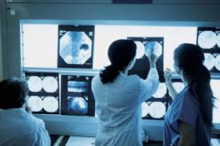
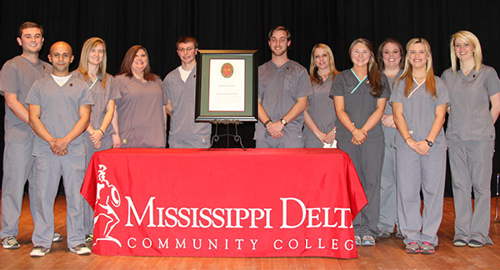
Radiologic Technology
2 Year AAS Degree Program
Admission Requirements
18 ACT score (15 if taken before October 28, 1989) for first time freshman with not college credit hours
16 ACT score (12 if taken before October 28, 1989) with 12 hours college credit (course approved) with a “C” average or better on courses that are approved by the RT.
Completion of A&P 1 and 2 (lecture and lab) with “C” or better within the last 5 years prior to admission
Completion of Fundamentals of Radiology with a “C” or better average
Entrance Test within 18 months of application deadline. Can only be taken 2 times 45 days apart during the application year if you submit testing taken at any other time the score will not be accepted
Must be 18 years of age at the start of the program
Application Period-November - April 1st
A radiologic technologist (radiographer) is a skilled professional that is qualified to perform imaging examinations and radiologic procedures at the request of physicians. The radiographer functions to ensure consistent radiographic images with minimal exposure to personnel and patients. Graduates of the program are awarded an Associate of Applied Science degree and are eligible to write the American Registry of Radiologic Technology (ARRT) examination.

Slide 10
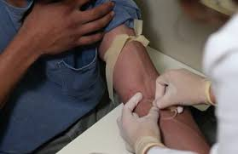
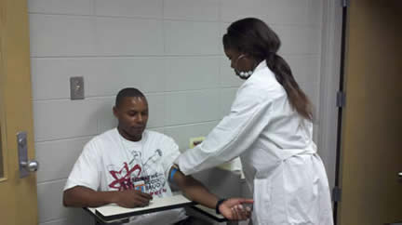
Phlebotomy Technician
1 Semester Certificate Program
Admission Requirements
High School diploma or GED/HiSet
18 ACT score (15 if taken before October 28, 1989) for first time freshman with not college credit hours
16 ACT score (12 if taken before October 28, 1989) with 12 hours college credit (course approved) with a “C” average or better on courses approved by the Phlebotomy program faculty
Must be 18 years of age at the start of the program
Application Period
  Fall- May 1st – July 1st
  Spring- Sept. 1st – Nov. 30th
Phlebotomy is the study or art of drawing blood for diagnosing and treating health problems or for blood donation. People who specialize in this study are called phlebotomy technicians. Phlebotomy technicians work in hospitals, clinics, blood banks, clinical laboratories and diagnostic centers. Phlebotomy technicians play an important role in health care. The primary job of a phlebotomy technician is to take blood samples from patients. This evening course is ideal for health professionals seeking to expand their current skills, for currently employed phlebotomists seeking certification, or for those interested in a profession in laboratory medicine.
Does not require entrance test

Slide 11

Nursing
Associate Degree Nursing
Practical Nursing
Health Care Assistant

Slide 12
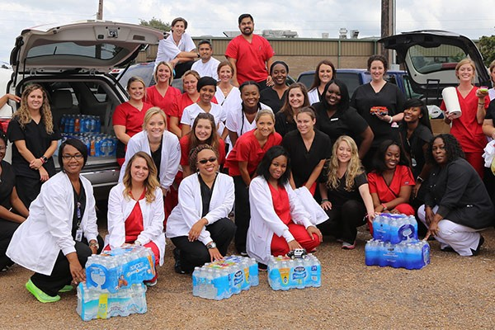
Associate Degree Nursing
2 Year AAS Degree Program
Admission Requirements
18 ACT score (15 if taken before October 28, 1989) for first time freshman with not college credit hours
16 ACT score (12 if taken before October 28, 1989) with 12 hours college credit (course approved) with a 2.5 GPA or better on courses that are approved by the college.
Completion of A&P 1 and 2 (lecture and lab) with “C” or better within the last 5 years prior to admission
Must be 18 years of age at the start of the program
Entrance Test within 18 months of application deadline. Can only be taken 2 times 45 days apart during the application year if you submit testing taken at any other time the score will not be accepted
Application Period-November- March 1st
The Associate Degree Nursing Program prepares nurses at the basic level of entry for professional nursing practice. The curriculum is designed to prepare graduates to practice safe, effective nursing and function as team members after passing the National Council Licensing Examination for RNs (NCLEX-RN®). A registered nurse means that a person has graduated from an approved nursing program, passed the NCLEX-RN® examination, and is licensed by the state. The nurse practices within the legal and ethical rules and regulations established by the Mississippi Board of Nursing as determined by the Mississippi Nursing Practice Law (Nurse Practice Act).

Slide 13
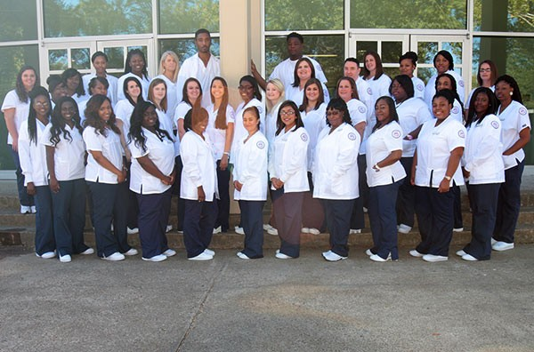
Practical Nursing
1 Year Certificate Program
Admission Requirements
16 ACT score (12 if taken before October 28, 1989)
Entrance Test within 18 months of application deadline. Can only be taken 2 times 45 days apart during the application year if you submit testing taken at any other time the score will not be accepted
Must be 18 years of age at the start of the program
Application Period-November- April 1st
The MDCC Practical Nursing (PN) Program is a three-semester program that prepares graduates with the knowledge and skills needed to meet the expanding health care needs of the community. Graduates of the program are awarded a certificate and are eligible to write the National Council Licensure Examination for Practical Nurses (NCLEX-PN®). Graduates must apply to the Mississippi Board of Nursing for licensure to practice as a Licensed Practical Nurse in the State of Mississippi.

Slide 14
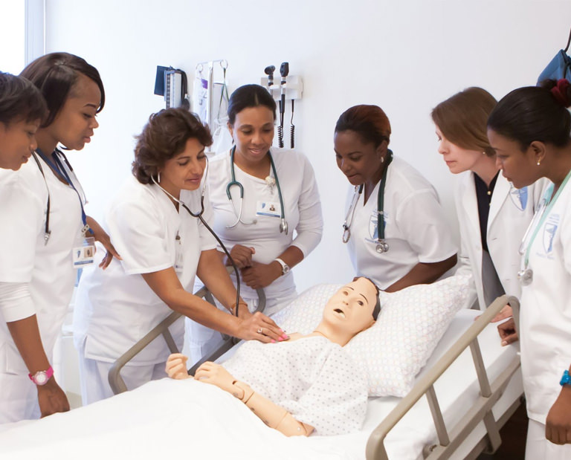
Health Care Assistant
1 Semester Certificate Program
Classes are held at GHEC (Greenville), Golden Age Nursing Home (Greenwood), MDCC Main Campus (Moorhead)
Admission Requirements
Be a high school graduate or have a satisfactory High School Equivalency score (GED or HiSET) OR be currently enrolled in the MDCC MiBest program
14 ACT score(9 or 10 if taken before October 28, 1989) or 14 Accuplacer score
Application Period
  Fall- May 1st – July 1st
  Spring- Sept. 1st – Nov. 1st
  *The Health Care Assistant program at MDCC may allow up to 15% admission for high-risk students (students who do not meet admission criteria).
  Does not require an Entrance Test
The Health Care Assistant program prepares the individual to assist in providing health care as a member of the health care team under the direction of a health care professional. The health care assistant works under the supervision of RN's, LPN's, and other medical personnel. The assistant may work in a variety of settings including, but not limited to, nursing homes or long term care, personal care facilities, hospitals, home health agencies, and private homes. Upon successful completion of the curriculum, students are eligible to sit for the National Nurse Aide Assessment Program Examination.

Slide 15
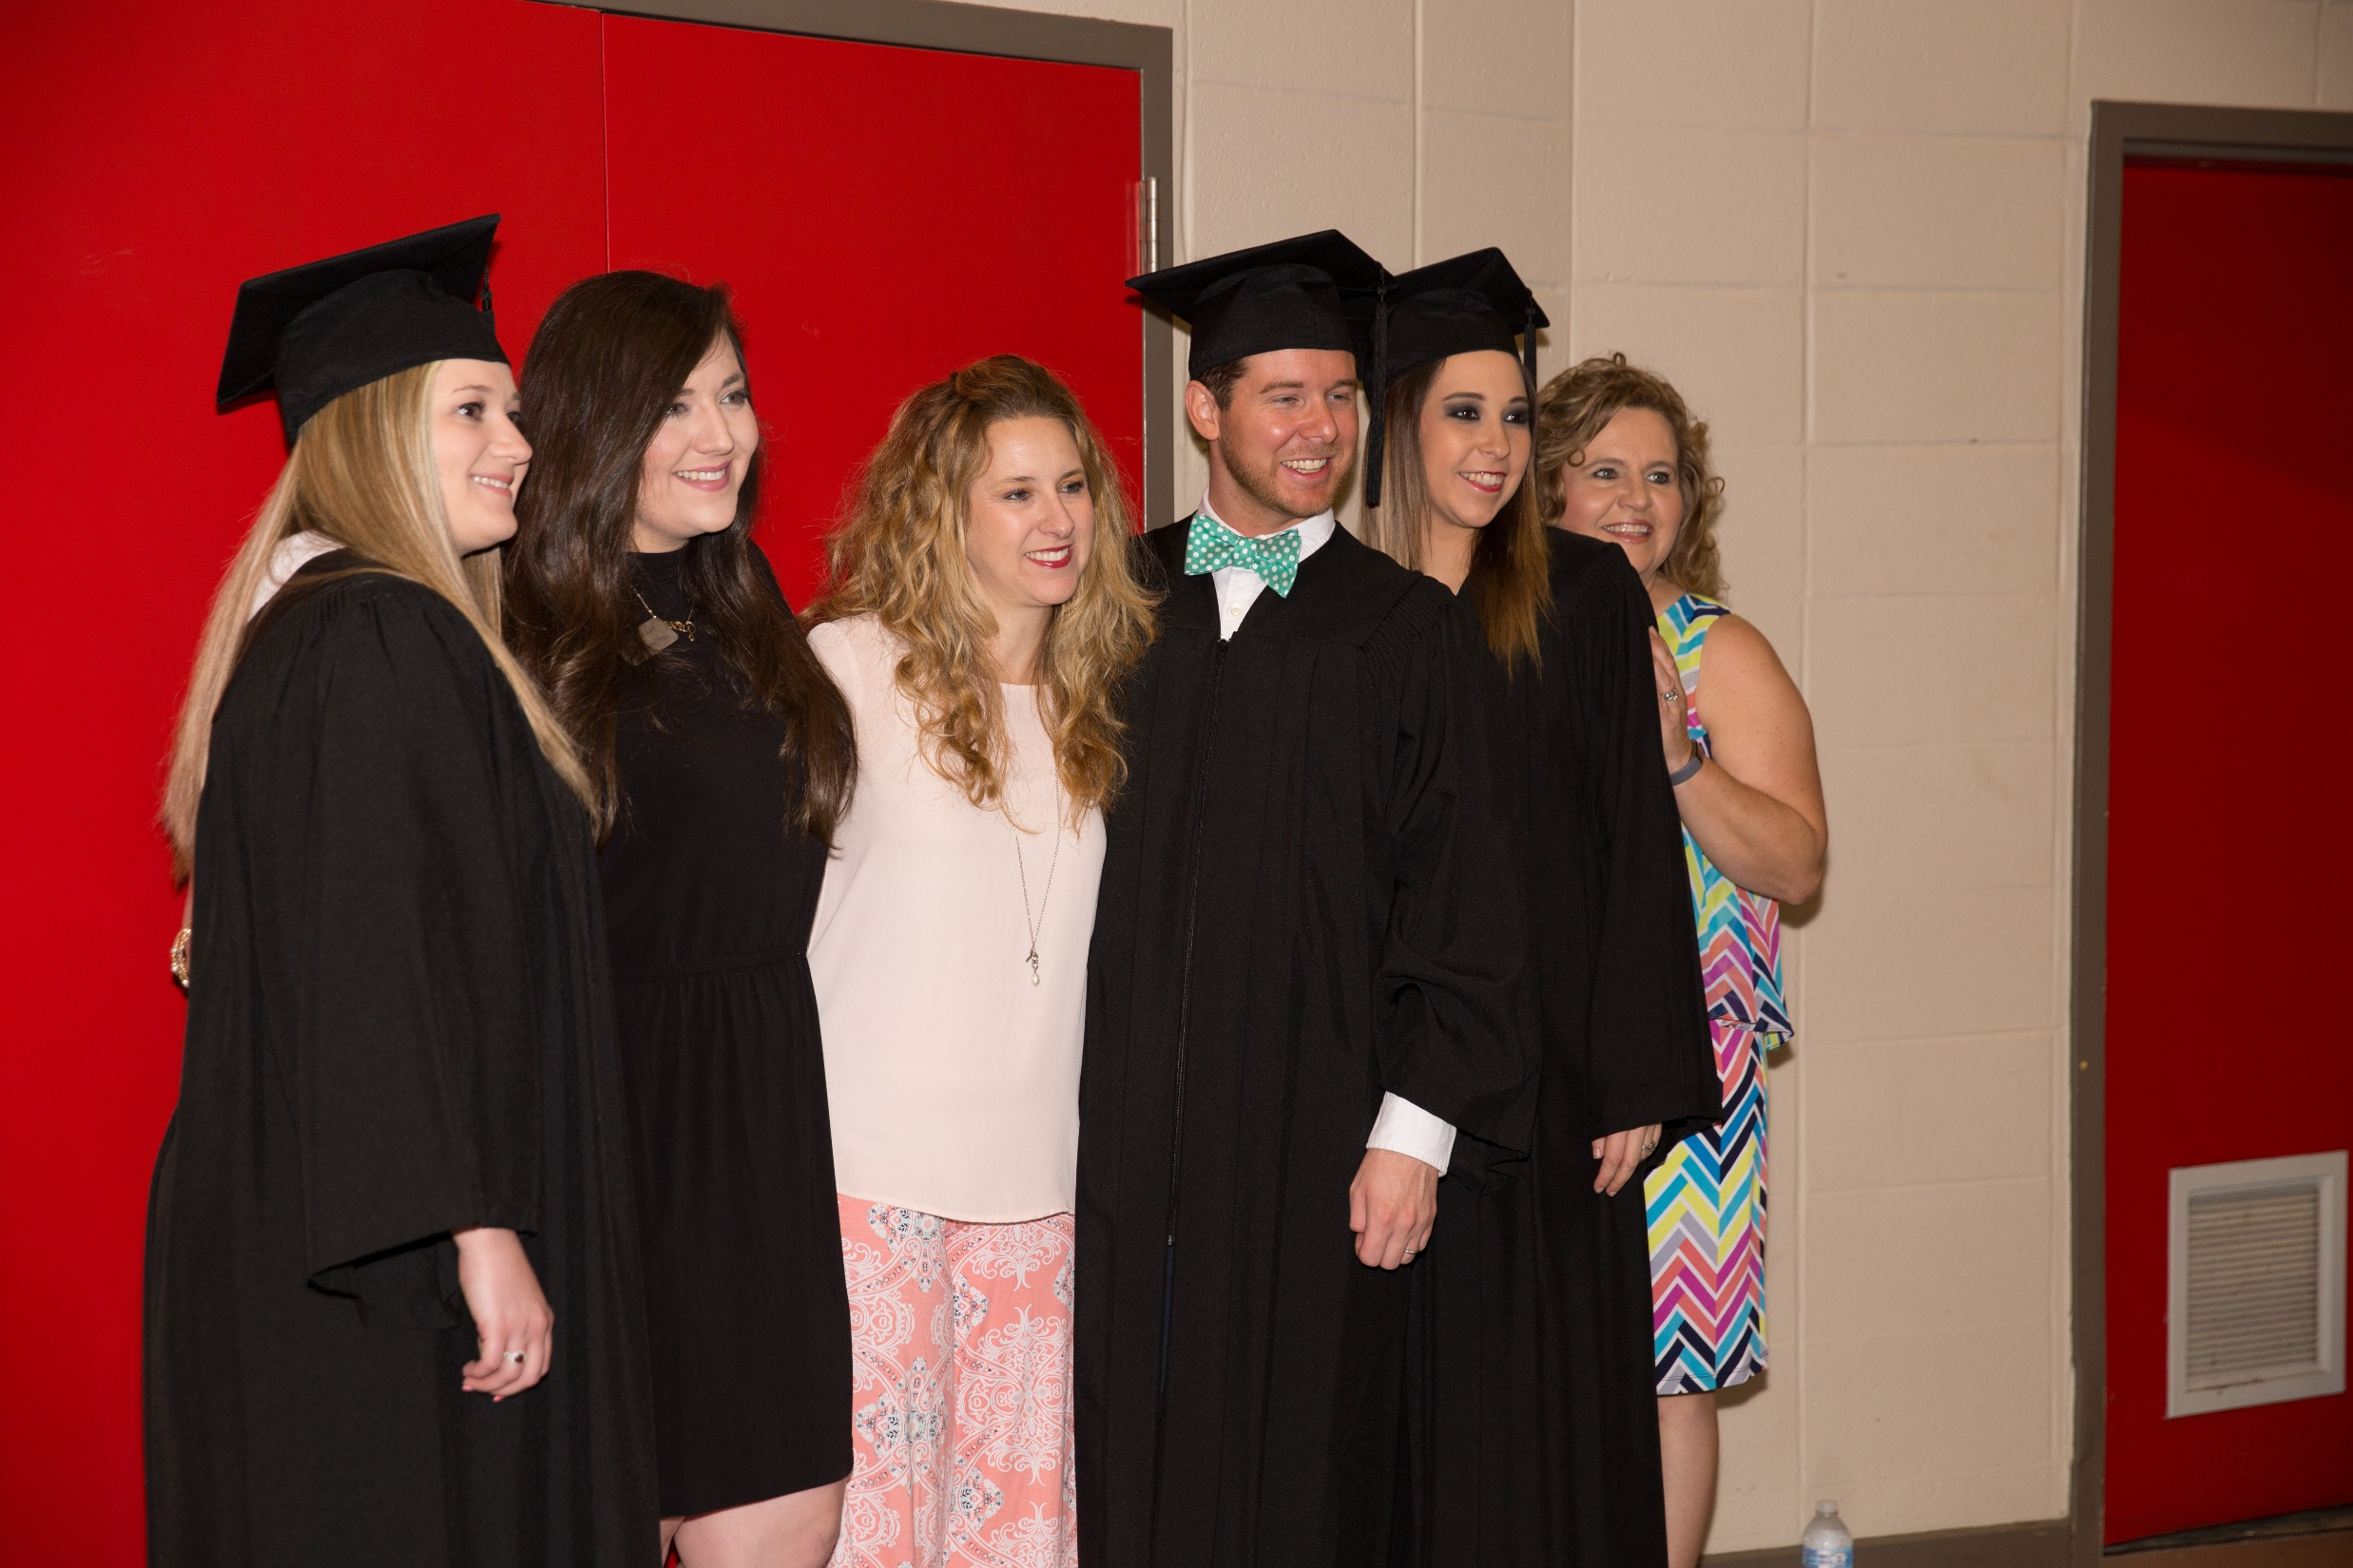
Health Science
Applications Process

Slide 16
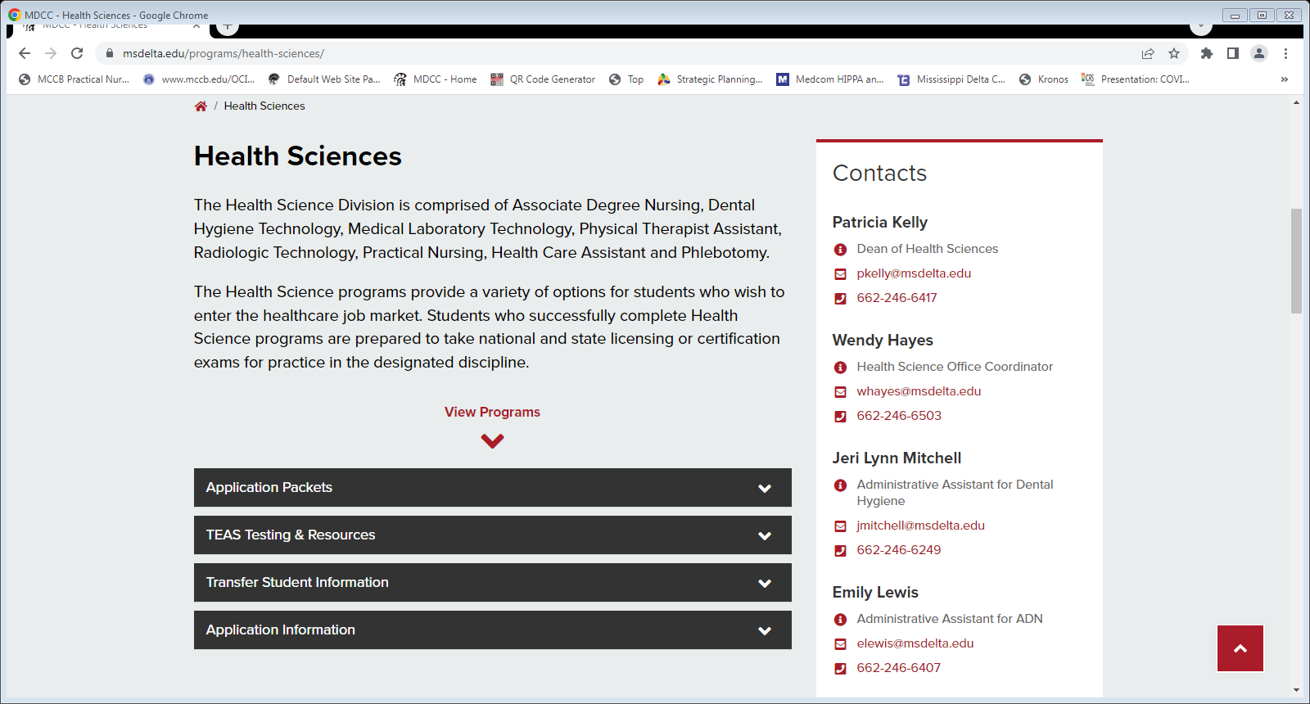
Application Deadlines
March 1st
Associate Degree Nursing
Dental Hygiene Technology
Physical Therapist Assistant
April 1st
Practical Nursing
Medical Laboratory Technology
Radiologic Technology
HCA and Phlebotomy
  Fall-July 1st
  Spring- Nov. 30th
  Summer-May 16th (HCA Only)
Visit the MDCC website at www.msdelta.edu to apply for college admission and obtain your application packet

Slide 17
First apply for MDCC general admission

Slide 18
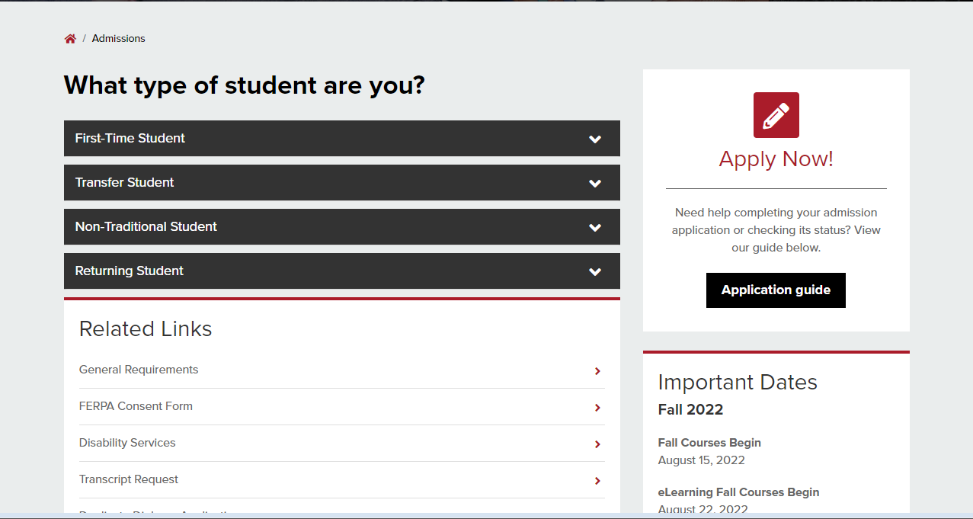
Apply for Admission or Readmission or Transfer Student

Slide 19
Deadlines and Minimum Requirements To Apply will be indicated in each application
NOTE: Incomplete applications will not be reviewed for admission into the program!
Example provided is from the MLT application

Slide 20
ACT, Transcripts, TEAS Test
Each program will have set due dates
Example provided is from the MLT application
Note the new statement on TEAS testing

Slide 21
Associate Degree Nursing Applications:
Emily Lewis
Division of ADN
Mississippi Delta Community College
P O Box 668
Moorhead, MS 38761
Mail your application to address listed on Page 1!
All other Health Science Programs:
Wendy Hayes
Division of Allied Health
Mississippi Delta Community College
P O Box 668
Moorhead, MS 38761
ACCEPTANCE LETTERS WILL BE SENT AS INDICATED IN THE SELECTION PROCESS SECTION
Example provided is from the Dental Hygiene
application

Slide 22
Selection Process:
If accepted into the program, a list of what will be expected of you is provided here and in your acceptance letter. Pleases note each programs’ requirements are different.
Example provided is from the ADN application

Slide 23
Programs requiring A&P or other
academic courses prior
to admission:
This means prior to start of the
Program NOT prior to application.
However, it is highly encouraged to
begin working on these
requirements as early as possible.
CPR, Background Check, and
Drug Screen will be performed
by MDCC if you are accepted into
the program. Information will be
provided in the acceptance letter.
Example provided is from the PTA application

Slide 24
Health form, vaccination
requirement, and orientation
information will be included
in acceptance letter. A Form 121
Immunization Record is
required. This information is not
required as part of the application process.

Slide 25
Application includes a policy of
acceptance of transfer students.
Each program has unique standards
pertaining to transfer of credit hours.
Example provided is from the ADN application

Slide 26
 | Score |  | Point Scale | Points Earned
ACT Score |  | 16-17 | ½
 |  | 18-21 | 1
 |  | 22-24 | 2
 |  | 25or > | 3
Cumulative GPA (Transcript)
Grade Point Average in Relevant Course Work Approved by Program (Based on min 12 hours) | * | 2.5-2.99 | ½
 |  | 3.0-3.49 | 1
 |  | 3.5-3.74 | 2
 |  | 3.75-4.0 | 3
Program Approved Credit Hours Courses with a ‘C’ or higher | * | 12-17 | 1
 |  | 18-25 | 2
 |  | 26-35 | 3
TEAS Scores
Individual Total |  | 62.0% or > | 1
Reading |  | 66% or > | 1
Math |  | 65.6% or > | 1
Previous Degree Awarded (Highest)
Requirements for consideration: Degree/Certificate must be of Science or Healthcare emphasis awarded from an accredited college/university. | Associate | Year: | ½
 | Bachelor | Year: | 1
 | Masters | Year: | 1½
Healthcare Experience
Health Related Work Experience or Military Equivalent+ | Describe |  | 1
 | Years:
Observation hours: ½ points awarded for each 10 hours over the minimum (20 hrs.) not to exceed 2 points
 |  |  | TOTAL
Rating Scale For Admission
Each program utilizes an objective rating
scale during the selection process.
This scale can be found in the application.
Rev. 22
*Calculate Based On Relevant Courses (see program checklist)
Example provided is from the PTA application

Slide 27
Rating Scale For Admission
GPA is calculated using academic course work approved
by the program and based on a minimum of 12 hours.
The courses utilized are found on the program’s check sheet.
Check Sheets can be found on the program’s web-site
Example from MLT

Slide 28
The Application
Complete all information. We need current address, phone number, and email to keep in contact with you.
Example provided is from the ADN application

Slide 29
If you plan to retake the ACT before the application deadline, please tell us here!
ACT scores are NOT printed on transcripts, so you will need to provide us with a copy!
Please let us know if you are currently enrolled at MDCC!
Example provided is from the ADN application

Slide 30
Please review the:
Substance Use Policy
Background Information Policy
Core Performance Standards/Minimum Technical Standards for each program
Example provided is from
the ADN application

Slide 31
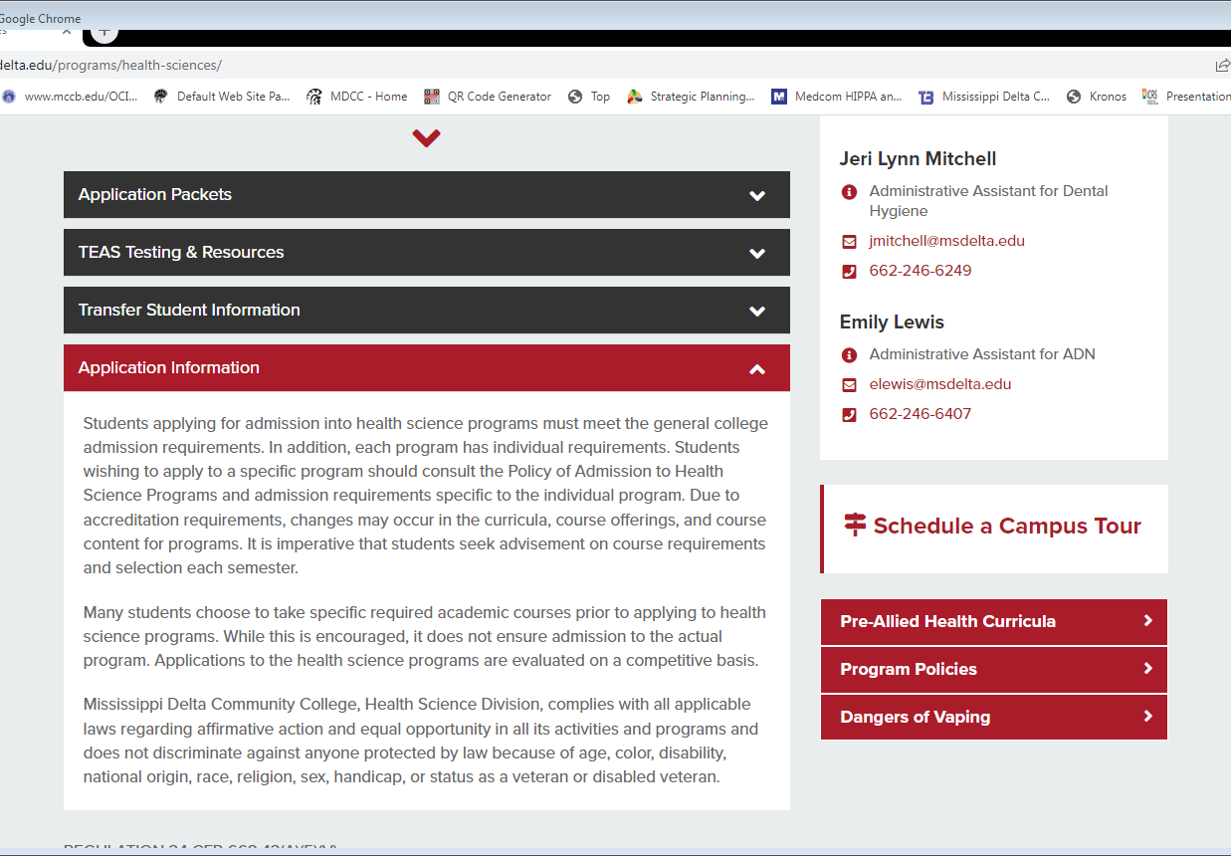
Drug Screen, Background Check,
General : Admission,
Readmission, and Transfer
Policy can be found on the
Health Sciences’ Home page
under ‘Program Policies’

Slide 32
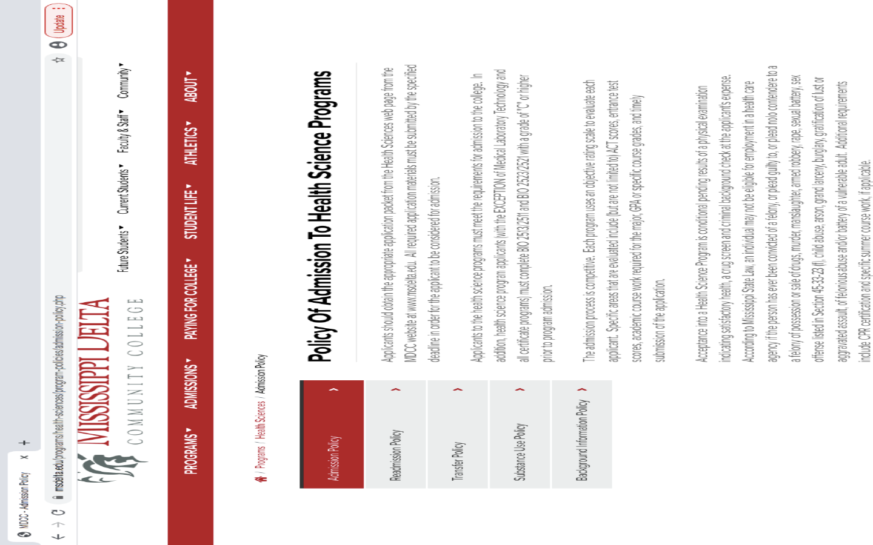
Program
Policies

Slide 33
Core Performance Standards / Minimum Technical Standards are different for each program.
These can be found on each programs’
Website page and are included in the application
Example provided is
from the ADN application

Slide 34
YES
NO
1.
Do you understand that if accepted into the
Physical T
herapist
Assistant
Program you will
be required to undergo a pre
-
admission drug screening performed by our office?
YES
NO
2.
**See our Substance Use Po
licy found on our website**
Do you understand that if accepted into the
Physical Therapist
Assistant
Program you will
be required to be fingerprinted by our office for a Healthcare Criminal History background
check?
**See our Background Informatio
n Policy found on our website**
YES
NO
3.
Do you understand the
technical standards
that are considered essential for the practice of
Please read the concluding
statement carefully and
you MUST sign Your Application
physical therapy assistant
listed below?
These include:
communication standards,
cognitive and intellectual standards, mob
ility/motor skills, sensory abilities and
observational skills, and behavioral/professional standards.
**See our
Minimum Technica
l Standards for Physical Therapist
Assistant
**
ALL APPLICANTS SHOULD BE ADVISED OF THE FOLLOWING:
1.
Any statements made on th
is application which
time of making such statement
are
false and known to be false by the applicant at the
s
, shall be deemed fraudulent and subjects the applicant to disciplinary
2.
proceedings.
According to Mississippi State Law, an individual may not be eli
gible for employment in a health care
agency if the person has ever been convicted of a felony , or plead guilty to , or plead nolo contendere to
a felony of possession or sale of drugs, murder, manslaughter, armed robbery, rape, sexual battery, sex
offens
e listed in Section 45
-
33
-
23 (f), child abuse, arson, grand larceny, burglary, gratification of lust or
aggravated assault, of felonious abuse and/or battery of a vulnerable adult.
I certify that the information
on this application is true and accurate.
_____________________________________________
____________________________
Applicant Signature
Date
Example provided is
from the PTA application
,

Slide 35
Each Program application
provides a cost Estimate
This is an ESTIMATE
Example provided is
from the RGT application

Slide 36
Step by Step Instructions for Registering for the TEAS test is found on the last pages of the application and the Health Sciences website.
TEAS testing will be offered Remotely (at home virtual) or paper (MDCC main campus). If you cannot meet the technical requirements listed, there are a limited number of computers available at the MDCC library (please call ahead to make sure one is available before you register with ATI).
The TEAS can be taken on any date
proctored by ATI. BUT it cannot be taken an
unlimited amount of times: It can be taken
2 times 45 days apart in the application year
(August 2022-May 2023). We will accept
a previous TEAS if you tested within the last
18 months.

Slide 37
Information on TEAS Testing
Can be found on the Health
Sciences’ main web page under
‘Important Dates & Workshop Resources’

Slide 38
The Dental Hygiene Program requires hours of observation

Slide 39
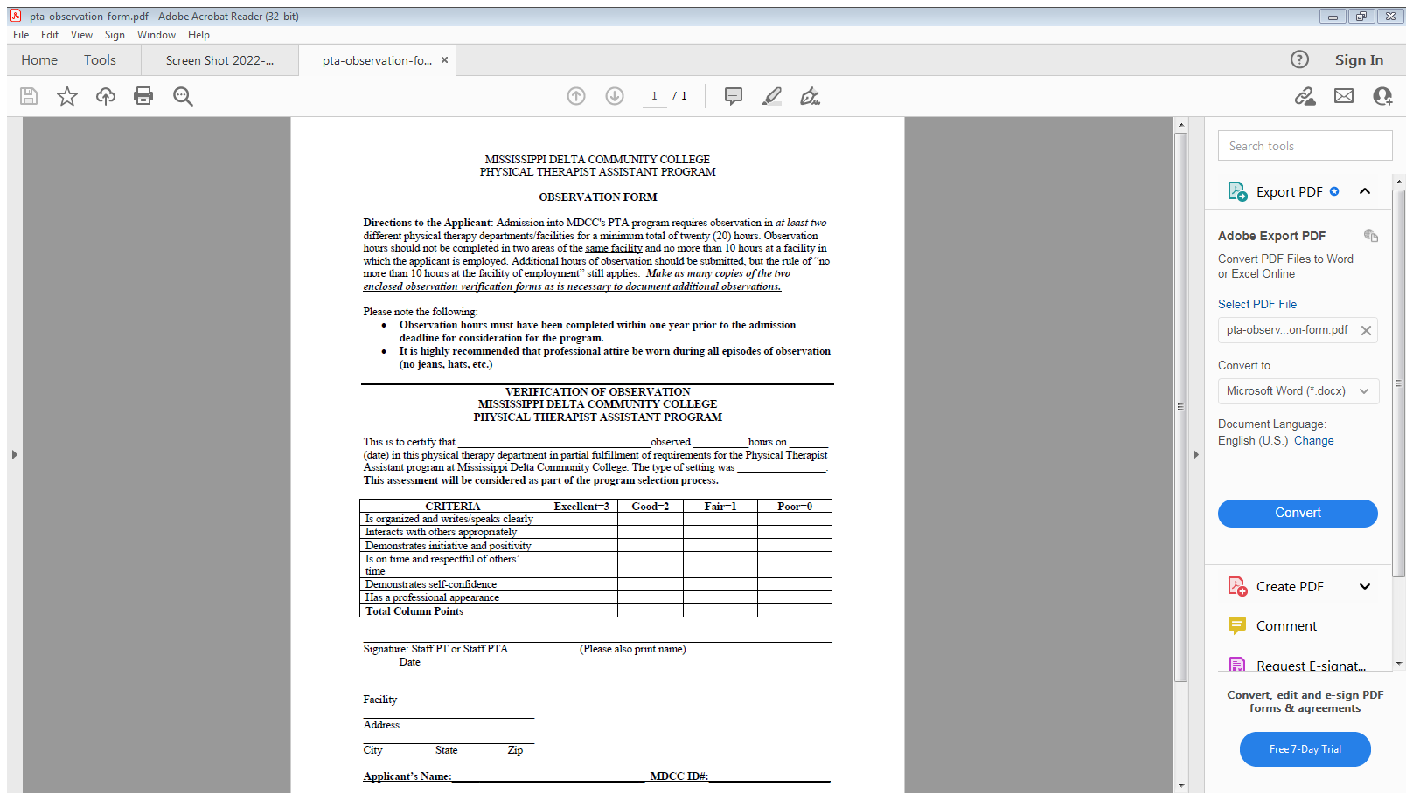
PTA Program required hours of observation time.

Slide 40
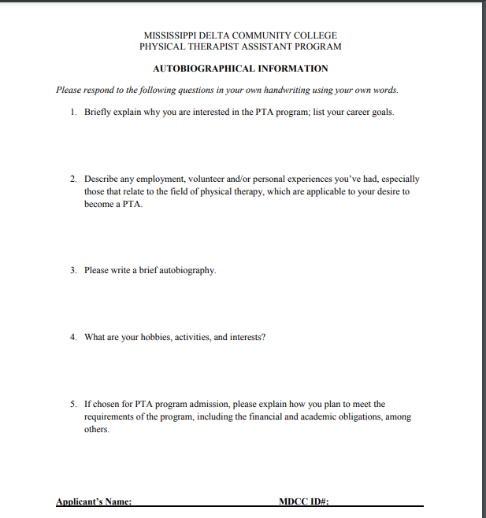
Must complete Autobiographical Form to apply for PTA program.

Slide 41
Professional Licensure
REGULATION 34 CFR 668.43(A)(5)(V)
Per federal regulation 34 CFR 668.43(a)(5)(v) institutions are required to publicly disclose whether programs that are designed to lead to professional licensure or certification meet the educational requirements of all U.S. states and territories. Mississippi’s community colleges offer several programs leading to professional licensure and agreed to collaborate, where applicable, to reduce duplication of effort and to ensure system-wide compliance with federal laws, regulations, and the State Authorization Reciprocity Agreement. Through reasonable and good faith effort, research has been done to determine whether or not each program meets licensure requirements, does not meet licensure requirements, or has not yet been determined for each state. Licensure and certification requirements are set by agencies that are not controlled by or affiliated with Mississippi’s community colleges. These requirements, state laws, regulations, and policies can change at any time. If a program does not meet requirements or is undetermined, students should contact the Board in each state for more information.
Program licensure information can be found on each of the MDCC Health Science programs’ home page and by the link below:
https://www.mccb.edu/Professional-Licensure-Disclosures

Slide 42
If you have any question on a particular program’s
requirements of admission and/or application
Please visit the program’s website –
You will find contact information on each program’s home page.
We look forward to having you apply to our Health Science Programs
In compliance with Title VI and Title VII of the Civil Rights Act of 1964, Title IX of the Education Amendments of 1972 of the Higher Education Act, Section 504 of the Rehabilitation Act of 1973, the Americans with Disabilities Act of 1990, the Pregnancy Discrimination Act of 1978 and other applicable Federal and State Acts, Mississippi Delta Community College offers equal education and employment opportunities and does not discriminate on the basis of age, race, color, national origin, religion, sex, sexual orientation, gender identity or expression, physical or mental disability, pregnancy, or veteran status in its educational programs and activities or in its employment practices. The following have been designated to handle inquiries regarding these policies: EEOC Compliance/Non-Discrimination: Dr. Steven Jones, Vice President of Administrative and Student Services; 662.246.6304 or EEOC@msdelta.edu. Title IX: Nakeshia Fipps, Associate Dean of Student Services, 662.246.6444 or titleIX@msdelta.edu. Disability Support Services: Nakeshia Fipps, Associate Dean of Student Services, 662.246.6444 or ADAcompliance@msdelta.edu. The mailing address for the above-named representatives is P.O. Box 668, Moorhead, MS 38761.

